Slide 1

Continuous Random Variable
The Normal Distribution

Slide 2
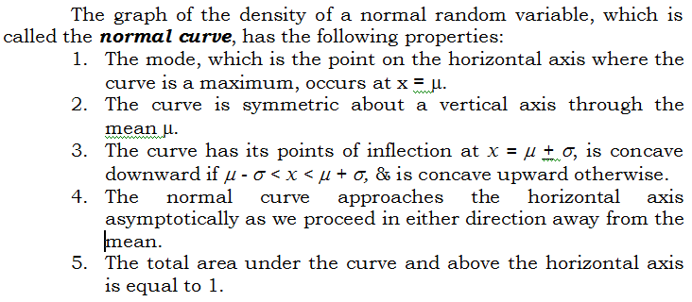
The Normal Curve

Slide 3
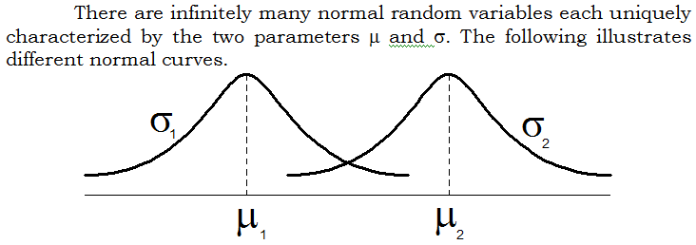
The Normal Curve

Slide 4
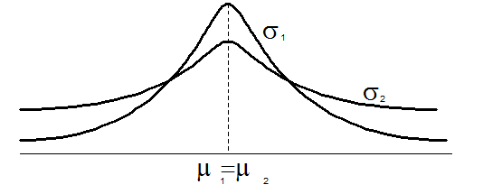
The Normal Curve

Slide 5
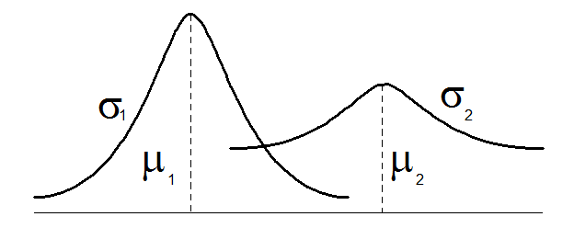
The Normal Curve

Slide 6
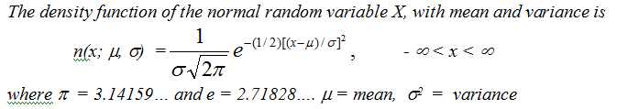
The Normal Distribution

Slide 7
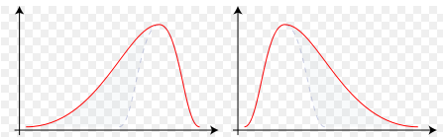
Chebyshev’s Rule
For any positive constant 'k', the probability
that a random variable will take on a value
within k standard deviations of the mean is
at least 1 - 1/k² .

Slide 8
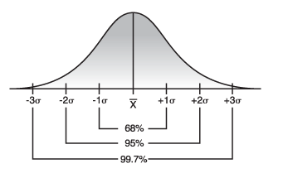
Empirical rule
For normally distributed data there will be approximately 68%
of the data within one standard deviation of the mean,
approximately 95% of the data within two standard deviations
of the mean, and approximately 99.7% of the data within
three standard deviations of the mean.

Slide 9
Example
The web site of Mapua states that fulltime students spend
an average of P2500 for textbooks each term. The
standard deviation of the amounts fulltime students
spend for textbooks per semester is known to be P500.

Slide 10
Example
The web site of Mapua states that fulltime students spend
an average of P2500 for textbooks each term. The
standard deviation of the amounts fulltime students
spend for textbooks per semester is known to be P500.

Slide 11
Standard Normal Distribution
Let X be a random variable that is normally distributed.
Then X can be transformed into a variable Z such that
f(x) = n(x;μ,σ) → f(z) = n(z;0,1)
Where z = (x – μ)/σ

Slide 12
Examples
Given a standard normal distribution, find the area under
the curve which lies
a) to the left of z = 1.43
b) to the right of z = -0.89
c) between z = -2.16 and z = -0.65
d) between z = -0.48 and z = 1.74

Slide 13
Example
Find the value of z if the value under a standard normal curve
a) to the right of z is 0.3622
b) to the left of z is 0.1131
c) between 0 and z, with z > 0, is 0.4838
d) between –z and z, with z > 0, is 0.95

Slide 14
Example
Given a normal distribution with μ = 30 and σ = 6, find
a) the normal-curve area to the right of x = 17;
b) the normal-curve area to the left of x = 22
c) the normal curve area between x = 32 and x = 41
d) the value of x that has 80% of the normal-curve area
to the left
e) the two values of x that contain the middle 75% of
the normal-curve area.

Slide 15
Example
The heights of 1000 students are normally distributed
with a mean of 174.5 cm and a standard deviation of
6.9 cm. How many of these students would you expect
to have heights
a) less than 160 cm?
b) between 171.5 cm and 182 cm?
c) at least 188 cm?

